Slide 1
Snake Game

Slide 2
Project Outline
The Snake Game built using Arduino, P5, and Tone.js! In this project, we have combined hardware and software elements to create a classic snake game that you can play on your computer screen while controlling the snake using an Arduino board and interacting with the game's audio using Tone.js.
This documentation will provide you with a description of the project, along with images, a video example, and relevant diagrams to help you understand the work. We will also share our thoughts about future development possibilities for this project.

Slide 3
Description
The Snake Game is a popular arcade game where the player controls a snake that moves around the screen, eating food and growing longer with each successful eat and avoiding obstacles and/or passing through with in 5 free pass. The game ends if the snake collides with the walls, its own body and obstacles. You control snake using 4 button Arduino(left, right, up and down) and use shift key on your keyboard to use free pass to avoid hitting obstacles and Tone.js to provide background music.

Slide 4
Hardware and Software Components
Hardware Components
Arduino board (e.g., Arduino Uno)
Breadboard
Jumper wires
USB cable for Arduino
Potentiometer (optional, for controlling game difficulty)
Speaker or headphones (for audio output)
Software Components
Arduino IDE: Used for programming the Arduino board.
P5.js: A JavaScript library for creating interactive graphics in the browser.
Tone.js: A Web Audio framework for creating interactive music and sound.

Slide 5
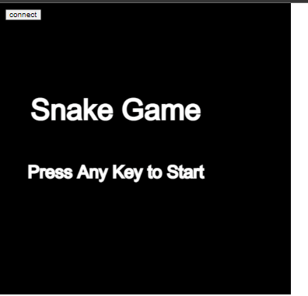
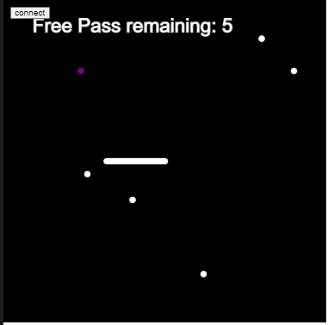
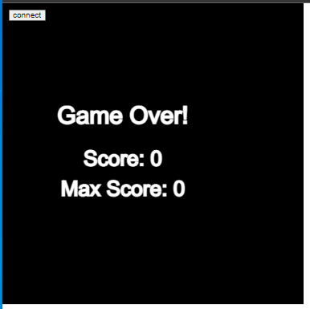
Game play Images
Link to play snake game online:
https://apatel19-stack.github.io/CSC2463/2463_Final_project/index.html

Slide 6
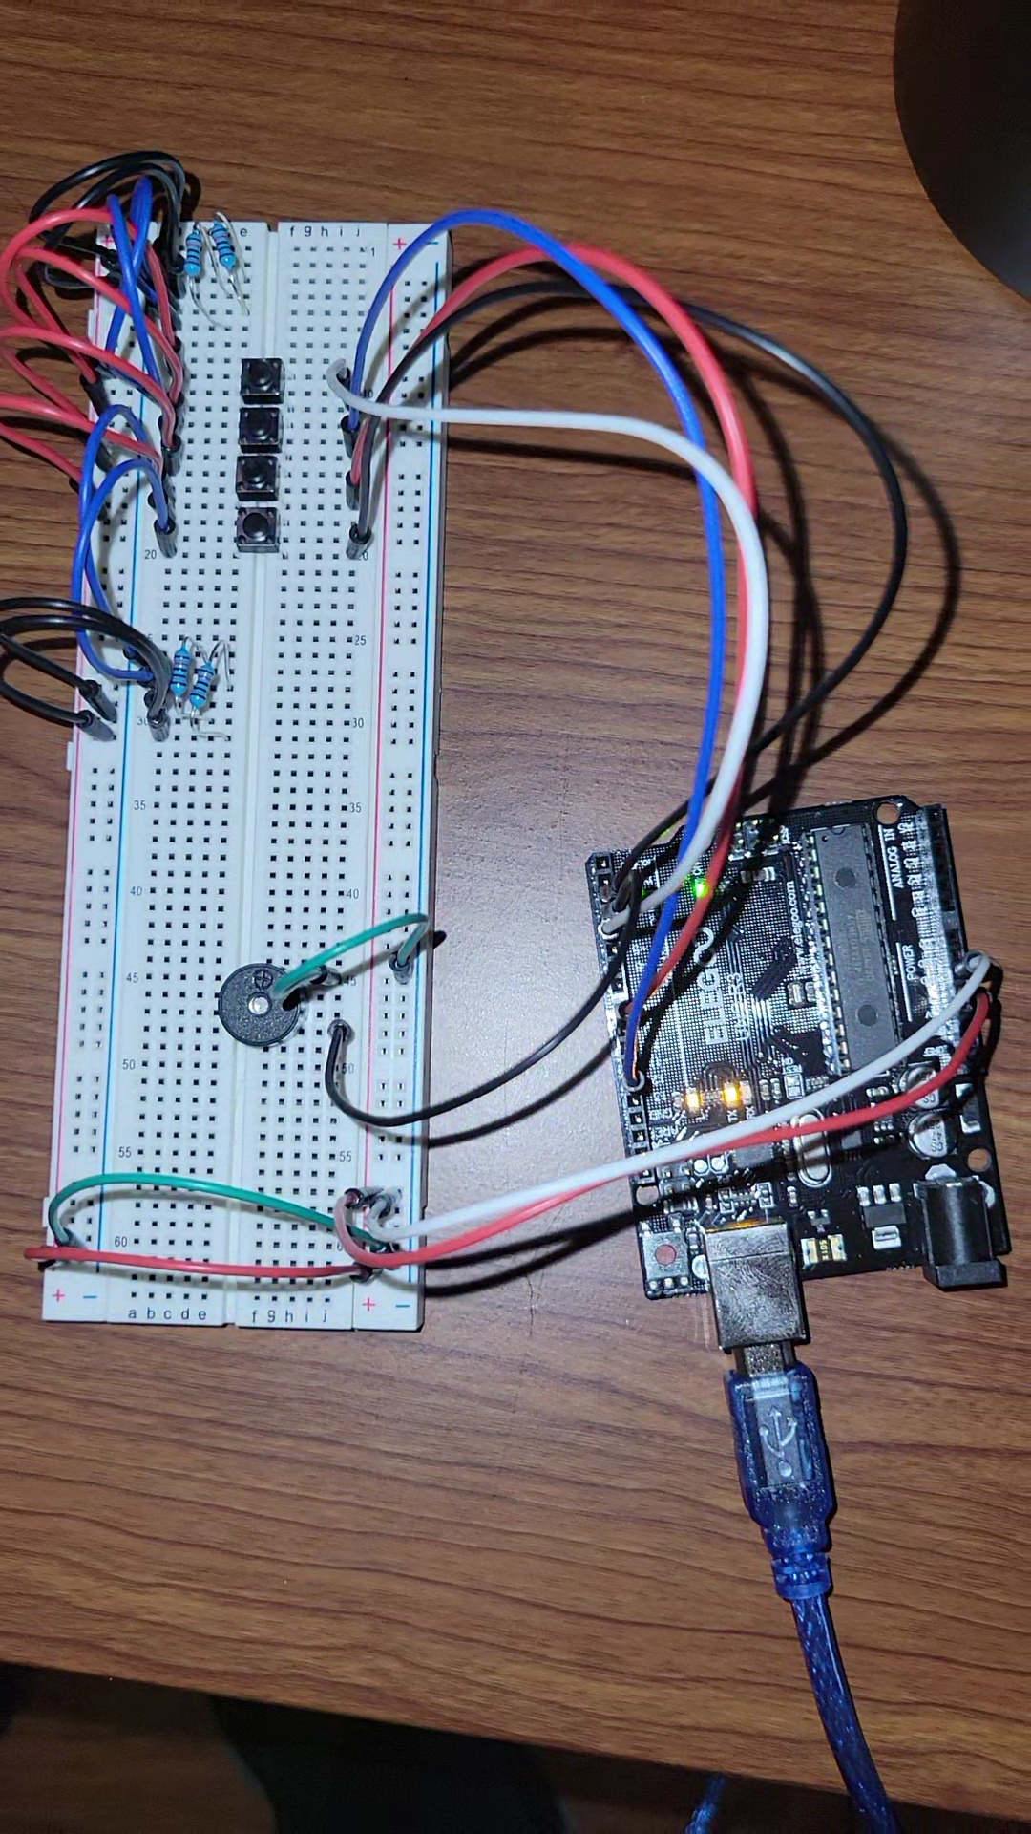
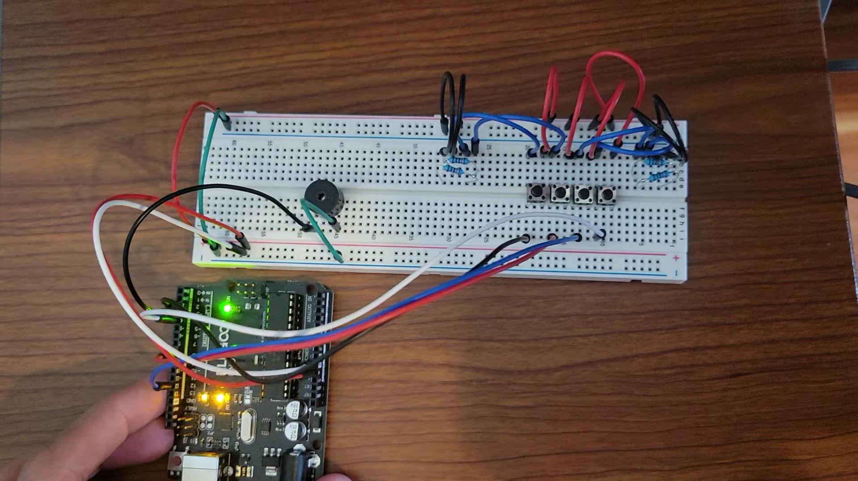
Arduino setup images

Slide 7
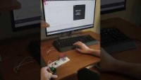
Video
Link: https://youtu.be/hYR_HB24Qjg

Slide 8
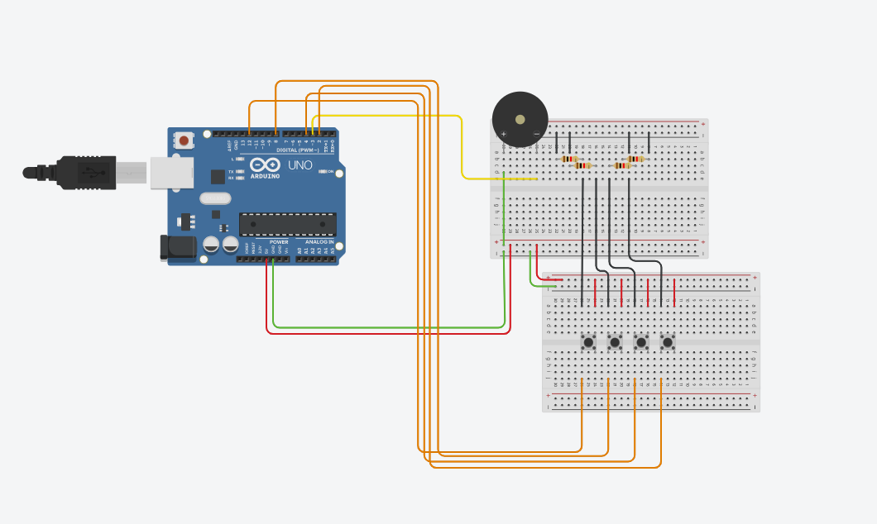
Circuit For Arduino

Slide 9

Future Development
Add levels which will has obstacle wall inside the canvas
Improve music quality
Improve snake graphics and add motion graphic in background

